Slide 1

22년 삼성 AI 전문가과정
6월 7일 화요일 4교시
장병탁
인공지능
5차시 : Knowledge-Based Agents
서울대학교 컴퓨터공학부
담당 교수: 장병탁
Seoul National University
Byoung-Tak Zhang

Slide 2
Lecture Overview
인공지능
5차시 : Knowledge-Based Agents
서울대학교 컴퓨터공학부
담당 교수: 장병탁
Seoul National University
Byoung-Tak Zhang

Slide 3
Introduction
Problem-solving (Reflex) agents (Previous lecture)
Knowledge is limited and inflexible, hidden in transition model Result(s, a)
Atomic representation of states is limited
Knowledge-based agents (This lecture)
Represent knowledge about the world
Deduce the actions to take from the knowledge
Representing knowledge using logic
Propositional logic (PL)
First-order logic (FOL)
First-order logic (FOL)
More expressive than PL

Slide 4
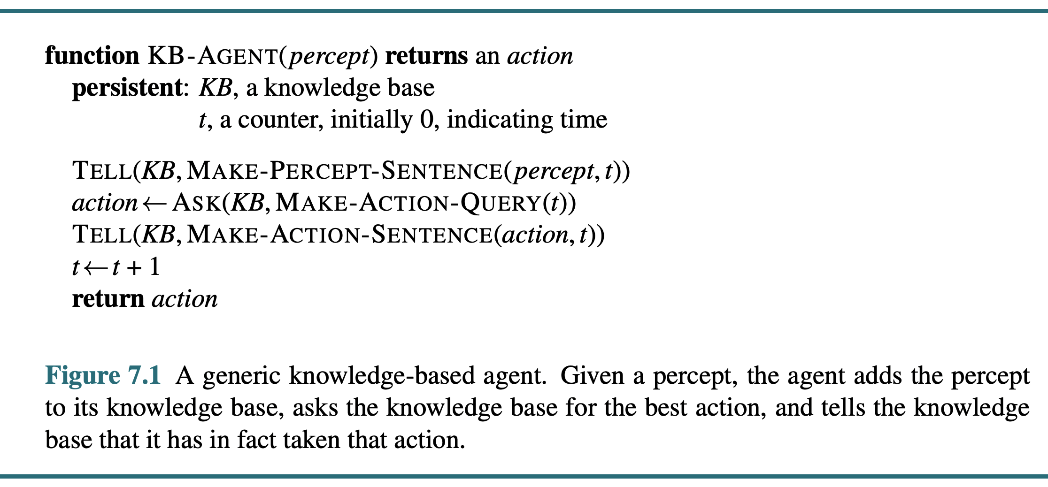
Knowledge-Based Agents
A simple knowledge-based agent
Inference engine
Knowledge base
Domain-independent
algorithms
Domain-specific
content
<출처> Stuart J. Russell and Peter Norvig (2021). Artificial Intelligence: A Modern Approach (4th Edition). Pearson

Slide 5
Representing Knowledge in Logic
Knowledge Base (Rules)
B ^ L => M
Sensors (Facts)
B
L
Query (Goal)
M?
Battery
Liftable
Movable
사진 출처 #1

Slide 6
Kinds of Logic
Logics in general (formal languages)
Language | Ontological Commitment (What exists in the world) | Epistemological Commitment (What an agent believes about facts)
Propositional logic First-order logic Temporal logic Probability theory Fuzzy logic | facts facts, objects, relations facts, objects, relations, times facts facts + degree of truth | true/false/unknown true/false/unknown true/false/unknown degree of belief known interval value

Slide 7
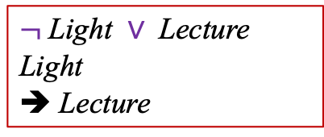
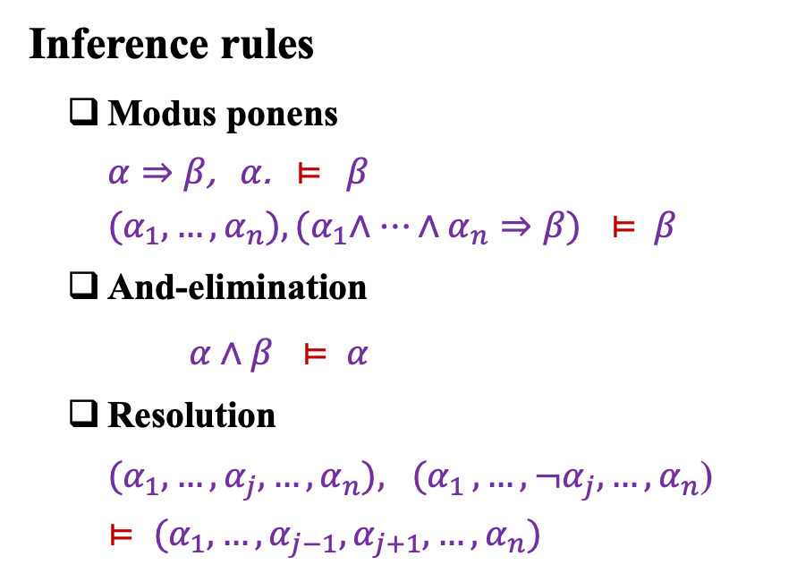
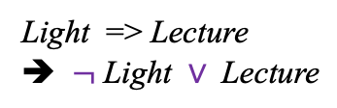
Propositional Logic & Inference
Inference rules
Modus ponens
$α⇒β$, $α$. $⊨$ $β$
${(α}_{1}, …, α_{n}), {(α}_{1}∧…∧α_{n}⇒β)$ $⊨$ $β$
And-elimination
$α∧β ⊨$ $α$
Resolution
${(α}_{1}, …, {α_{j},…,α}_{n}){, (α}_{1}, …, {¬α_{j},…,α}_{n}$)
$⊨$ ${(α}_{1}, …, {α_{j−1},α_{j+1},…,α}_{n})$
Light => Lecture
Light
➔ Lecture
Light => Lecture
➔ $¬$Light $∨$Lecture
$¬$Light $∨$Lecture
Light
➔ Lecture

Slide 8
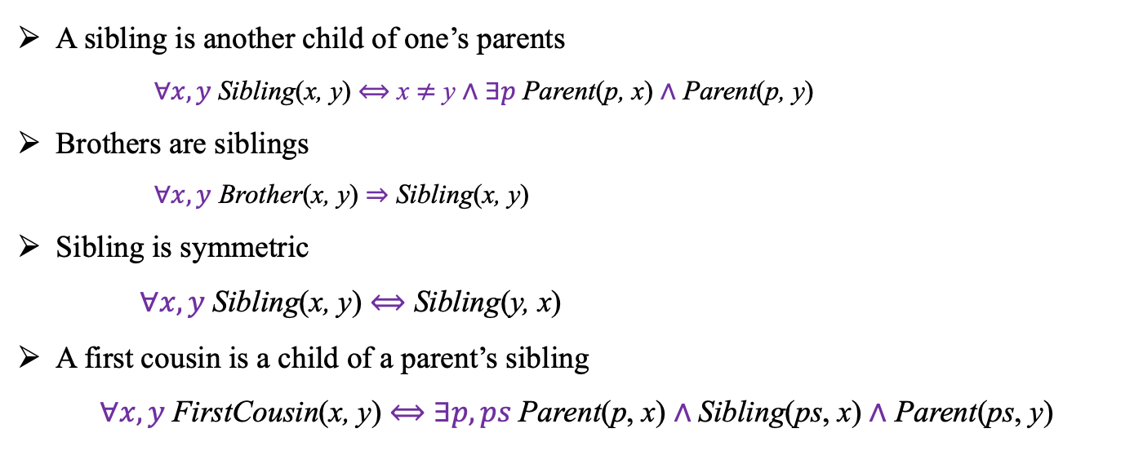
First-Order Logic
Family relationships: Sibling
A sibling is another child of one’s parents
$∀x, y$Sibling(x, y) $⟺$ x $≠$ y $∧$ $∃p$Parent(p, x) $∧$ Parent(p, y)
Brothers are siblings
$∀x, y$ Brother(x, y) ⇒ Sibling(x, y)
Sibling is symmetric
$∀x, y$Sibling(x, y) $⟺$ Sibling(y, x)
A first cousin is a child of a parent’s sibling
$∀x, y$FirstCousin(x, y) $⟺$ $∃p, ps$Parent(p, x) $∧$Sibling(ps, x) $∧$ Parent(ps, y)

Slide 9
Lecture 5. Knowledge-Based Agents
Knowledge-based Agents
What is knowledge?
Logical Agents: Knowledge in logic
Propositional Logic
Syntax and semantics
Propositional Inference
Forward and backward chaining
Resolution inference
First-Order Logic
Syntax and semantics
Using first-order logic

Slide 10
Outline (Lecture 5)
5.1 Knowledge-Based Agents ………………………..
5.2 Propositional Logic ……………………………....
5.3 Propositional Theorem Proving ………………….
5.4 First-Order Logic ………......................................
5.5 Using First-Order Logic ………...........................
Summary ……………………………………………..
10
14
20
33
42
45

Slide 11
5.1. Knowledge-Based Agents

Slide 12
5.1 Knowledge-Based Agents (1/2)
Inference engine
Knowledge base
Domain-independent algorithms
Domain-specific content
Knowledge base = A set of sentences in a formal language
Declarative approach to building an agent (or other system):
Tell it what it needs to known
Then it Ask itself what to do – answers should follow from knowledge base
Agents can be viewed at the knowledge level: what they know or at the implementation level
i.e. data structures and algorithms in knowledge base

Slide 13
5.1 Knowledge-Based Agents (2/2)
A simple knowledge-based agent
<출처> Stuart J. Russell and Peter Norvig (2021). Artificial Intelligence: A Modern Approach (4th Edition). Pearson

Slide 14
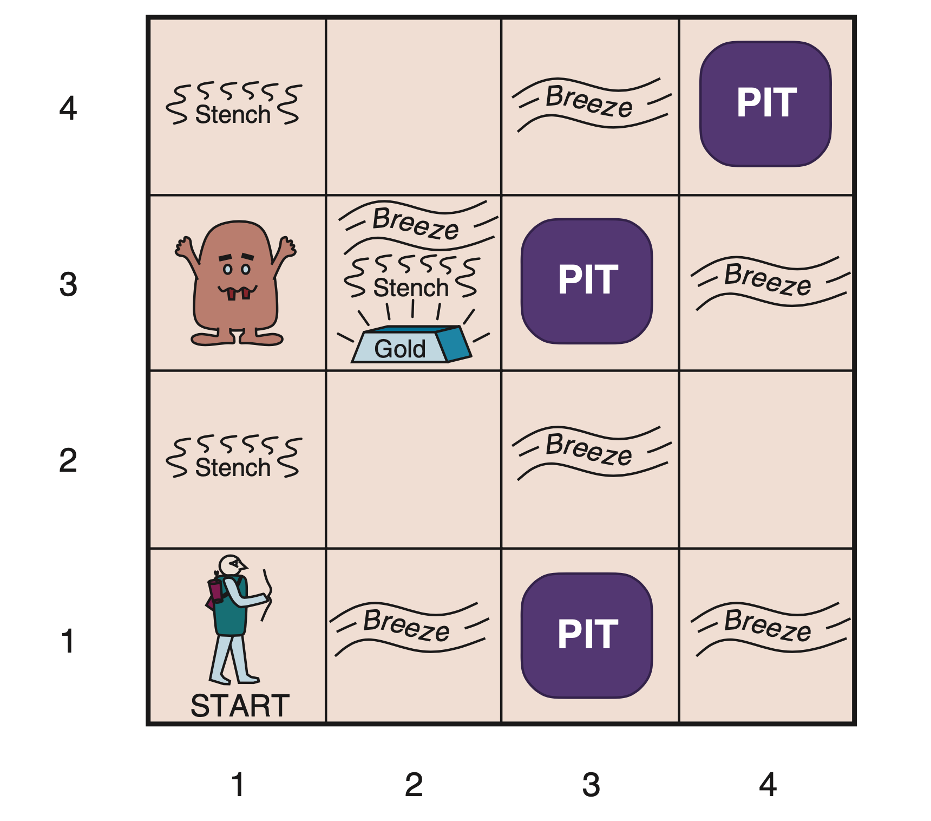
The Wumpus World
Sensors
Actuators
Knowledge Base
Stench Breeze Glitter Bump Scream OK Pit Visited Wumpus None
Forward TurnLeft TurnRight Grab Shoot Climb
None → OK OK → MoveForward Breeze → Pit Pit → TurnLeft Glitter → Gold Gold → Grab
B_{2,1} : It breezes at (2, 1)
P_{3,1} : There is a pit at (3,3)
<출처> Stuart J. Russell and Peter Norvig (2021). Artificial Intelligence: A Modern Approach (4th Edition). Pearson

Slide 15
5.2 Propositional Logic

Slide 16
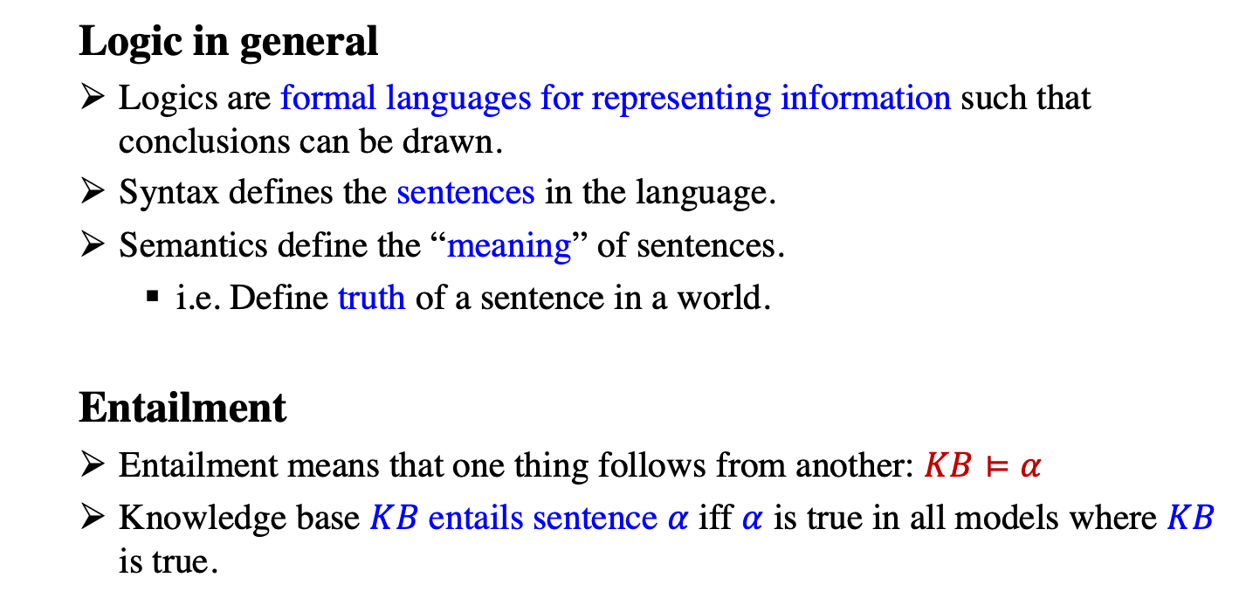
5.2 Propositional Logic (1/5)
Logic in general
Logics are formal languages for representing information such that conclusions can be drawn.
Syntax defines the sentences in the language.
Semantics define the “meaning” of sentences.
i.e. Define truth of a sentence in a world.
Entailment
Entailment means that one thing follows from another: $KB⊨α$
Knowledge base $KB$ entails sentence $α$ iff $α$ is true in all models where $KB$ is true.

Slide 17

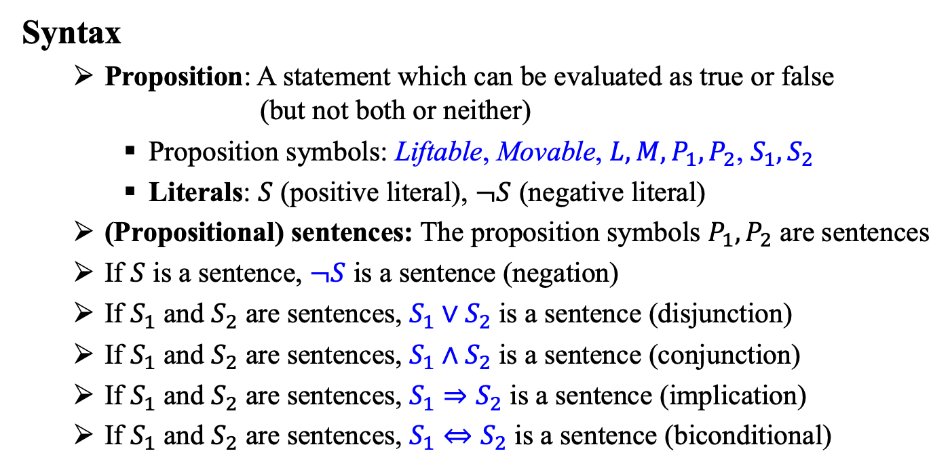
5.2 Propositional Logic (3/5)
Syntax
Proposition: A statement which can be evaluated as true or false (but not both or neither)
Proposition symbols: Liftable, Movable, ${L, M, P}_{1},P_{2}$, $S_{1}, S_{2}$
Literals: $S$ (positive literal), $¬S$ (negative literal)
(Propositional) sentences: The proposition symbols $P_{1},P_{2}$ are sentences
If $S$ is a sentence, $¬S$ is a sentence (negation)
If $S_{1}$ and $S_{2}$ are sentences, $S_{1}∨S_{2}$ is a sentence (disjunction)
If $S_{1}$ and $S_{2}$ are sentences, $S_{1}∧S_{2}$ is a sentence (conjunction)
If $S_{1}$ and $S_{2}$ are sentences, $S_{1}⇒S_{2}$ is a sentence (implication)
If $S_{1}$ and $S_{2}$ are sentences, $S_{1}⇔S_{2}$ is a sentence (biconditional)

Slide 18
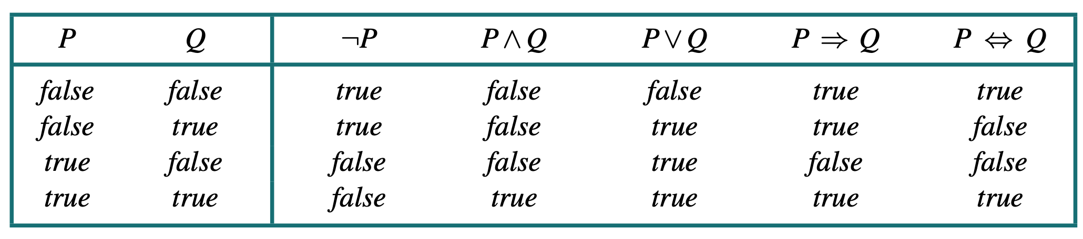
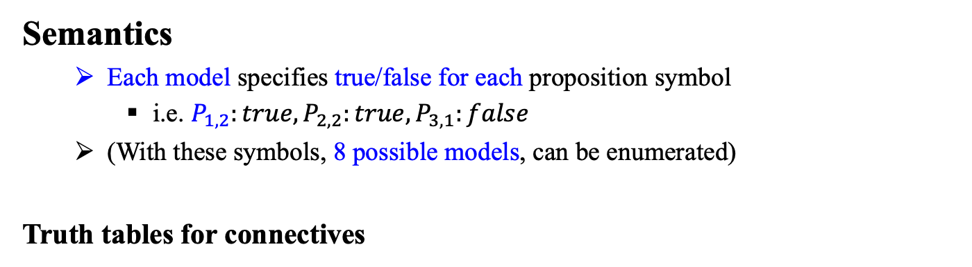
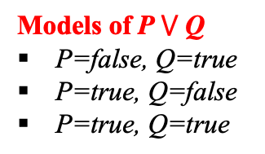
5.2 Propositional Logic (4/5)
Semantics
Each model specifies true/false for each proposition symbol
i.e. $P_{1,2}:true, P_{2,2}:true, P_{3,1}:false$
(With these symbols, 8 possible models, can be enumerated)
Truth tables for connectives
Models of P $⋁$ Q
P=false, Q=true
P=true, Q=false
P=true, Q=true
<출처> Stuart J. Russell and Peter Norvig (2021). Artificial Intelligence: A Modern Approach (4th Edition). Pearson

Slide 19
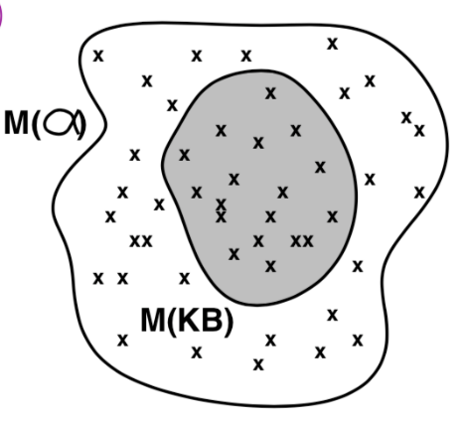
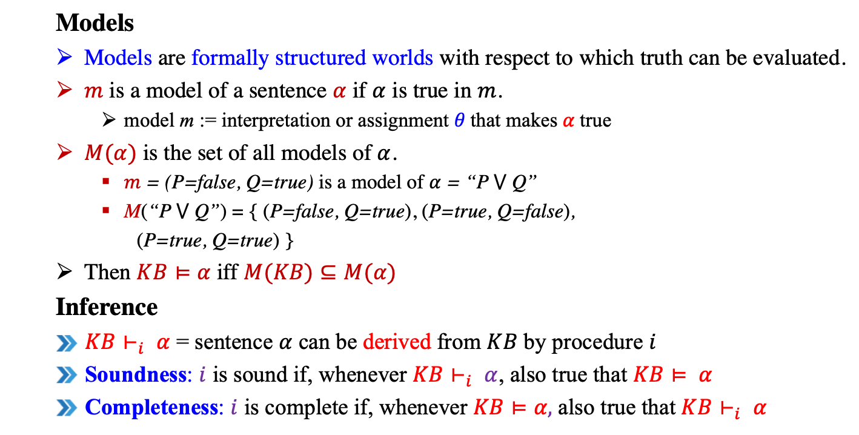
5.2 Propositional Logic (2/5)
Models
Models are formally structured worlds with respect to which truth can be evaluated.
$m$ is a model of a sentence $α$ if $α$ is true in $m$.
model m := interpretation or assignment 𝜃 that makes $α$true
$M(α)$ is the set of all models of $α$.
$m$ = (P=false, Q=true) is a model of $α$ = “P $⋁$ Q”
M(“P $⋁$ Q”) = { (P=false, Q=true), (P=true, Q=false),
(P=true, Q=true) }
Then $KB⊨α$ iff $M(KB)⊆M(α)$
Inference
$KB⊢_{i} α$ = sentence $α$ can be derived from $KB$ by procedure $i$
Soundness: $i$ is sound if, whenever $KB⊢_{i} α$, also true that $KB⊨ α$
Completeness: $i$ is complete if, whenever $KB⊨α,$ also true that $KB⊢_{i} α$

Slide 20
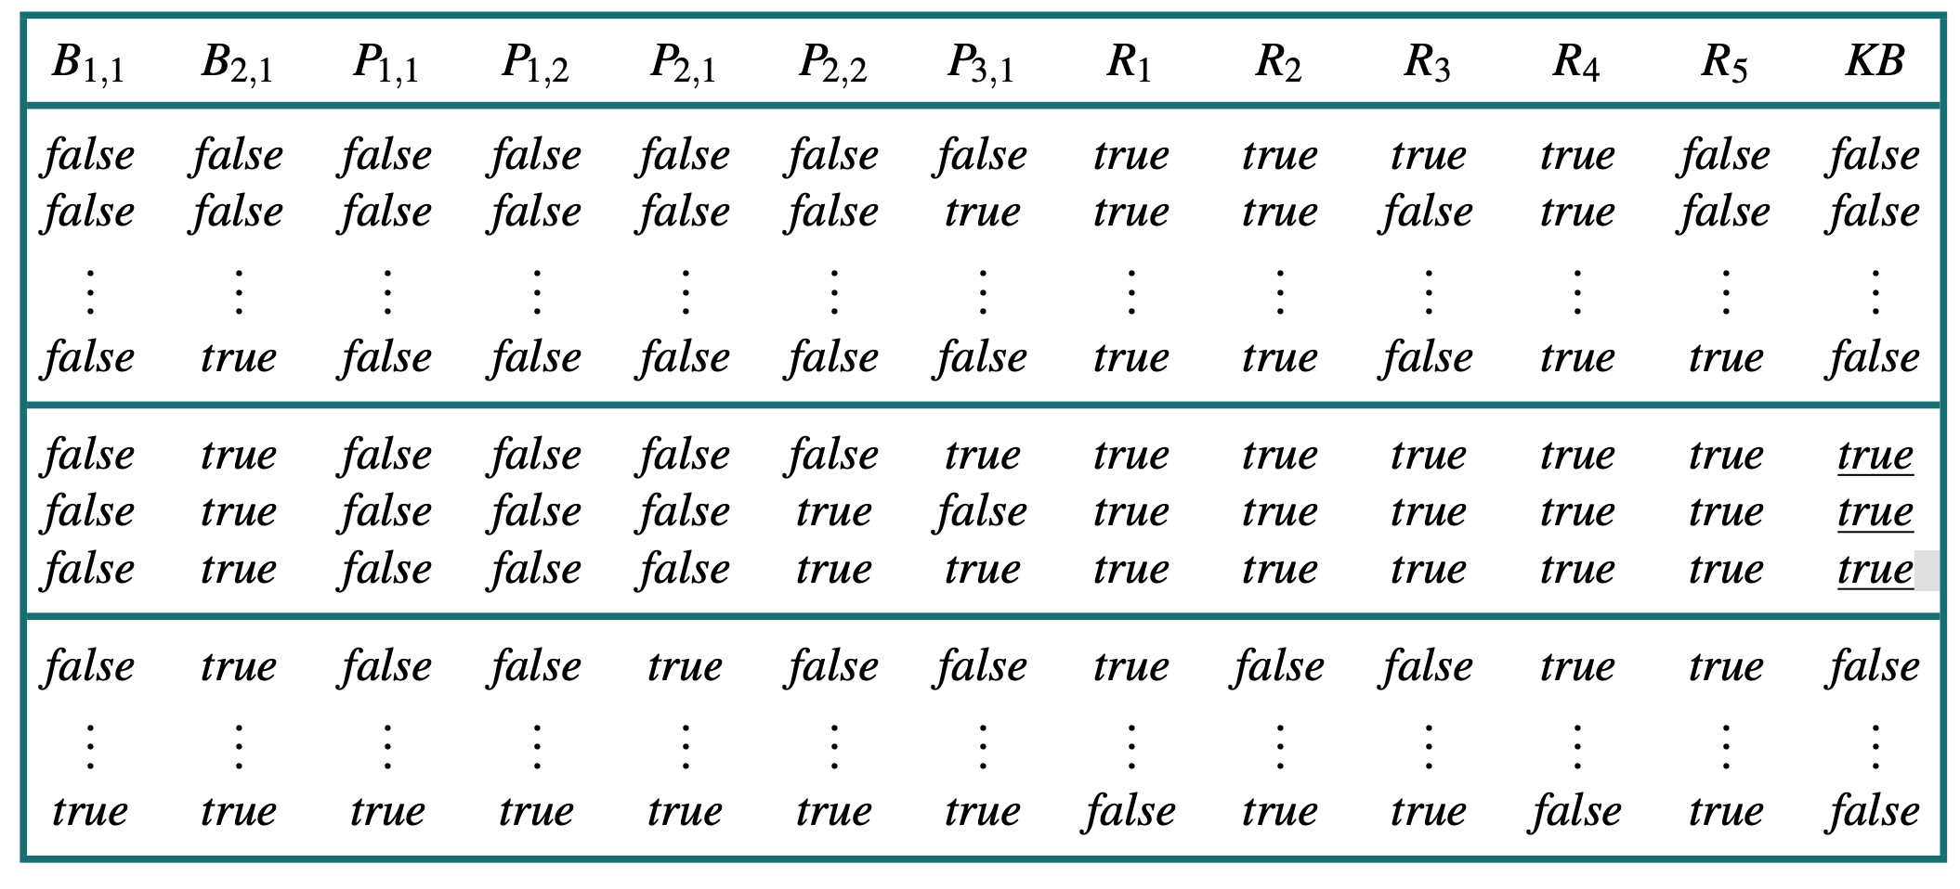
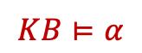
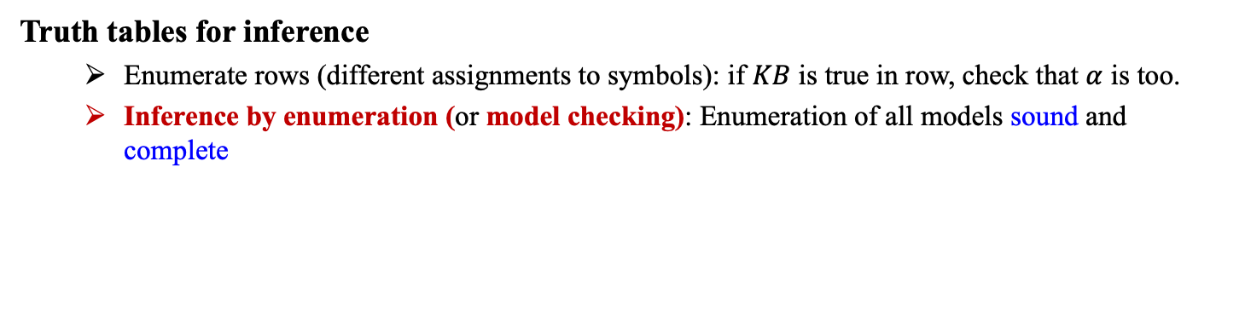
5.2 Propositional Logic (5/5)
Truth tables for inference
Enumerate rows (different assignments to symbols): if $KB$ is true in row, check that $α$ is too.
Inference by enumeration (or model checking): Enumeration of all models sound and complete
$$KB⊨α$$
<출처> Stuart J. Russell and Peter Norvig (2021). Artificial Intelligence: A Modern Approach (4th Edition). Pearson

Slide 21
5.3 Propositional Theorem Proving

Slide 22
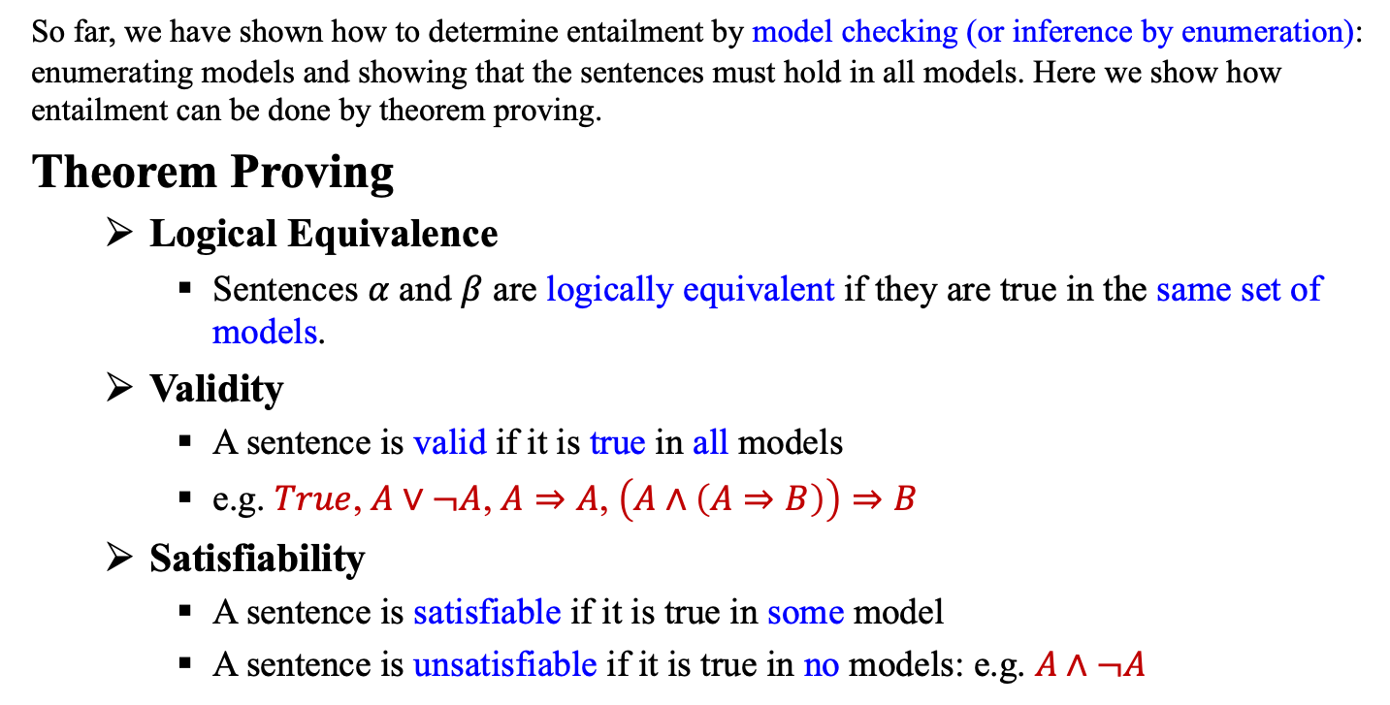
5.3 Propositional Theorem Proving (1/10)
So far, we have shown how to determine entailment by model checking (or inference by enumeration): enumerating models and showing that the sentences must hold in all models. Here we show how entailment can be done by theorem proving.
Theorem Proving
Logical Equivalence
Sentences $α$ and $β$ are logically equivalent if they are true in the same set of models.
Validity
A sentence is valid if it is true in all models
e.g. $True$, $A∨¬A$, $A⇒A$, $\left(A∧\left(A⇒B\right)\right)⇒B$
Satisfiability
A sentence is satisfiable if it is true in some model
A sentence is unsatisfiable if it is true in no models: e.g. $A∧¬A$

Slide 23
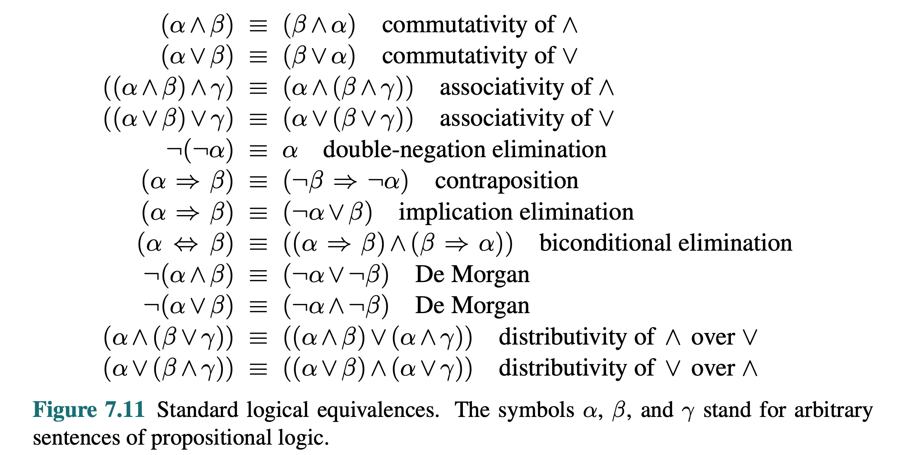
5.3 Propositional Theorem Proving (2/10)
<출처> Stuart J. Russell and Peter Norvig (2021). Artificial Intelligence: A Modern Approach (4th Edition). Pearson

Slide 24
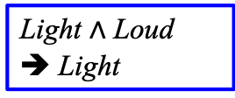
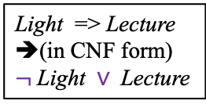
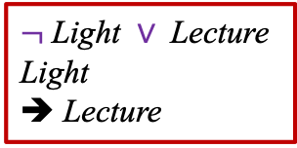
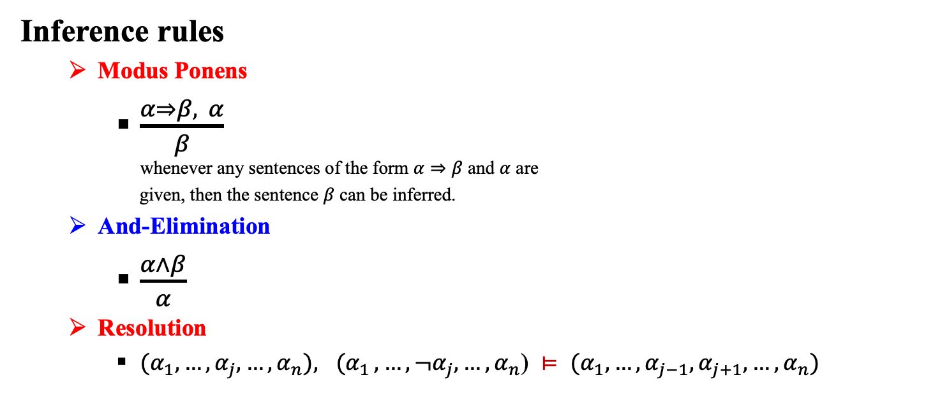
5.3 Propositional Theorem Proving (3/10)
Inference rules
Modus Ponens
$\frac{α⇒β, α}{β}$ whenever any sentences of the form $α⇒β$ and $α$ are
given, then the sentence $β$ can be inferred.
And-Elimination
$\frac{α∧β}{α}$
Resolution
${(α}_{1}, …, {α_{j},…,α}_{n}){, (α}_{1}, …, {¬α_{j},…,α}_{n}$) $⊨$ ${(α}_{1}, …, {α_{j−1},α_{j+1},…,α}_{n})$
Light => Lecture
Light
➔ Lecture
Light => Lecture
➔(in CNF form)
$¬$Light $∨$Lecture
Light $∧$ Loud
➔ Light
$¬$Light $∨$Lecture
Light
➔ Lecture

Slide 25
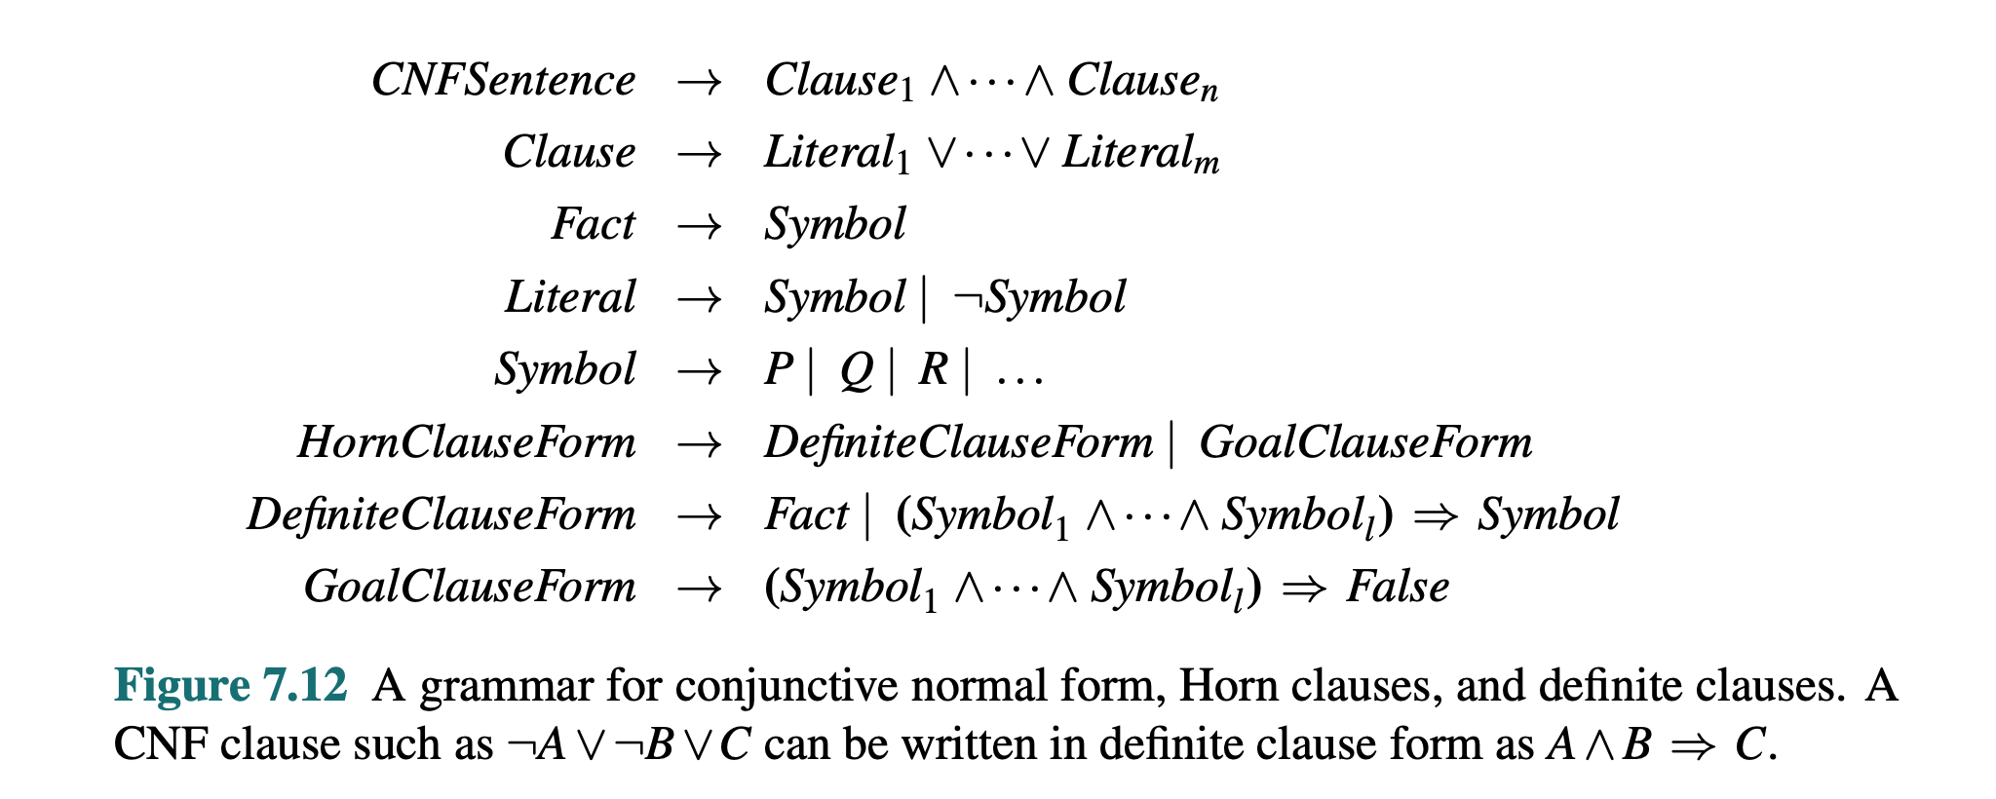
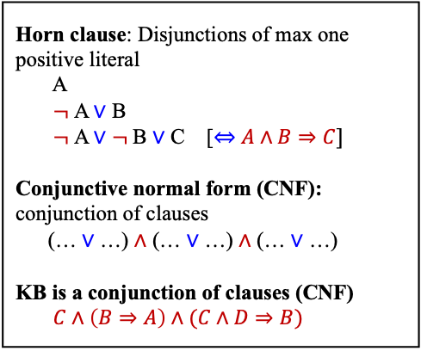
5.3 Propositional Theorem Proving (4/10)
Horn Clauses, Definite Clauses, and Conjunctive Normal Form (CNF)
Horn clause: Disjunctions of max one positive literal A $¬$A $∨$ B $¬$A $∨$ $¬$B $∨$ C [$⇔$ $A∧B⇒C]$ Conjunctive normal form (CNF): conjunction of clauses (… $∨$ …) $∧$ (… $∨$ …) $∧$ (… $∨$ …) KB is a conjunction of clauses (CNF) $C∧\left(B⇒A\right)∧(C∧D⇒B)$
<출처> Stuart J. Russell and Peter Norvig (2021). Artificial Intelligence: A Modern Approach (4th Edition). Pearson

Slide 26
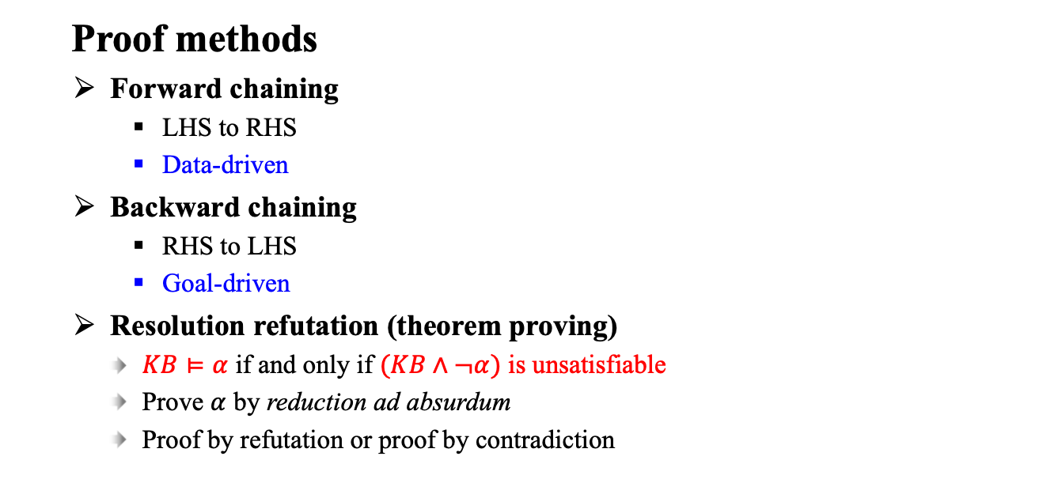
5.3 Propositional Theorem Proving (5/10)
Proof methods
Forward chaining
LHS to RHS
Data-driven
Backward chaining
RHS to LHS
Goal-driven
Resolution refutation (theorem proving)
$KB⊨α$ if and only if $(KB∧¬α)$ is unsatisfiable
Prove $α$ by reduction ad absurdum
Proof by refutation or proof by contradiction
<출처> Stuart J. Russell and Peter Norvig (2021). Artificial Intelligence: A Modern Approach (4th Edition). Pearson

Slide 27

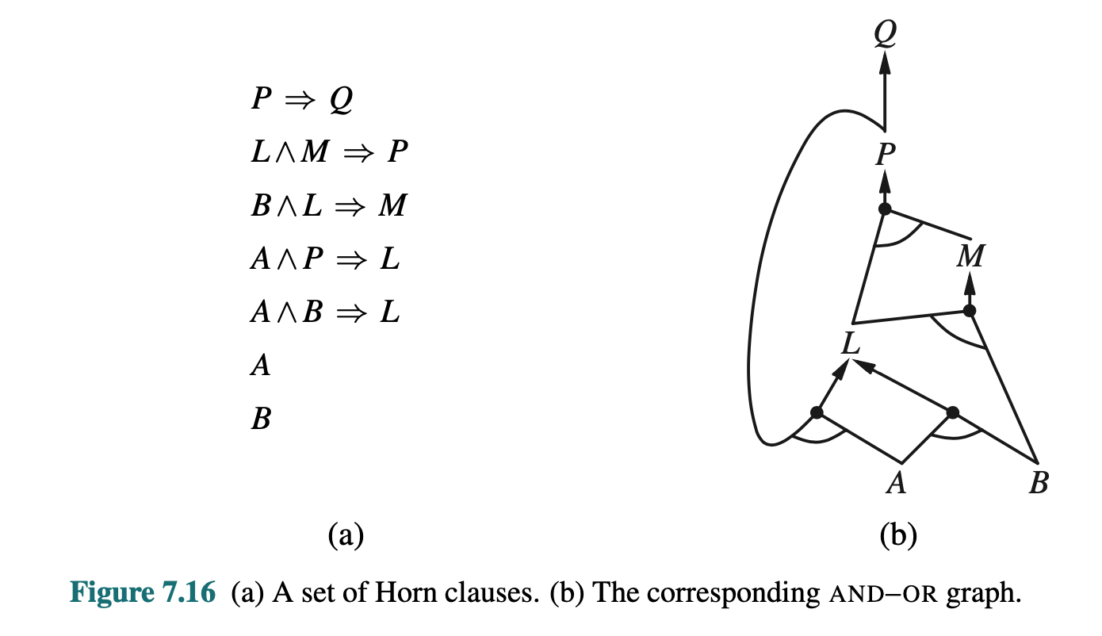
5.3 Propositional Theorem Proving (6/10)
Example
Backward chaining
Forward chaining
<출처> Stuart J. Russell and Peter Norvig (2021). Artificial Intelligence: A Modern Approach (4th Edition). Pearson

Slide 28
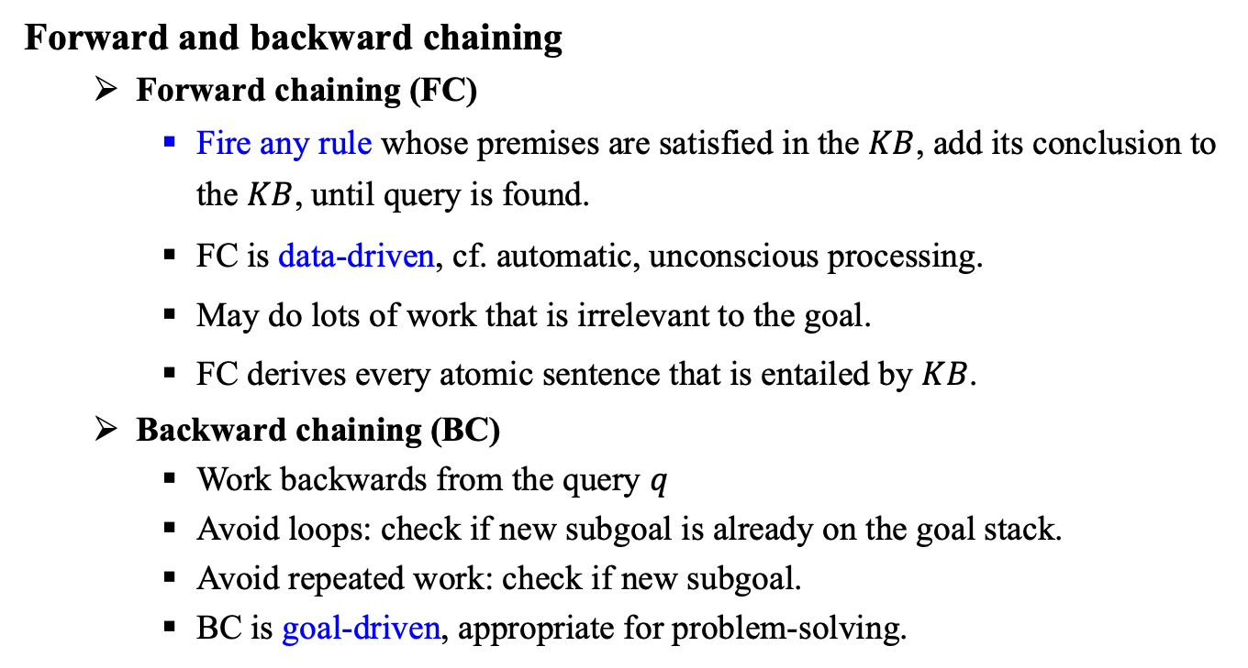
5.3 Propositional Theorem Proving (7/10)
Forward and backward chaining
Forward chaining (FC)
Fire any rule whose premises are satisfied in the $KB$, add its conclusion to the $KB$, until query is found.
FC is data-driven, cf. automatic, unconscious processing.
May do lots of work that is irrelevant to the goal.
FC derives every atomic sentence that is entailed by $KB$.
Backward chaining (BC)
Work backwards from the query $q$
Avoid loops: check if new subgoal is already on the goal stack.
Avoid repeated work: check if new subgoal.
BC is goal-driven, appropriate for problem-solving.

Slide 29
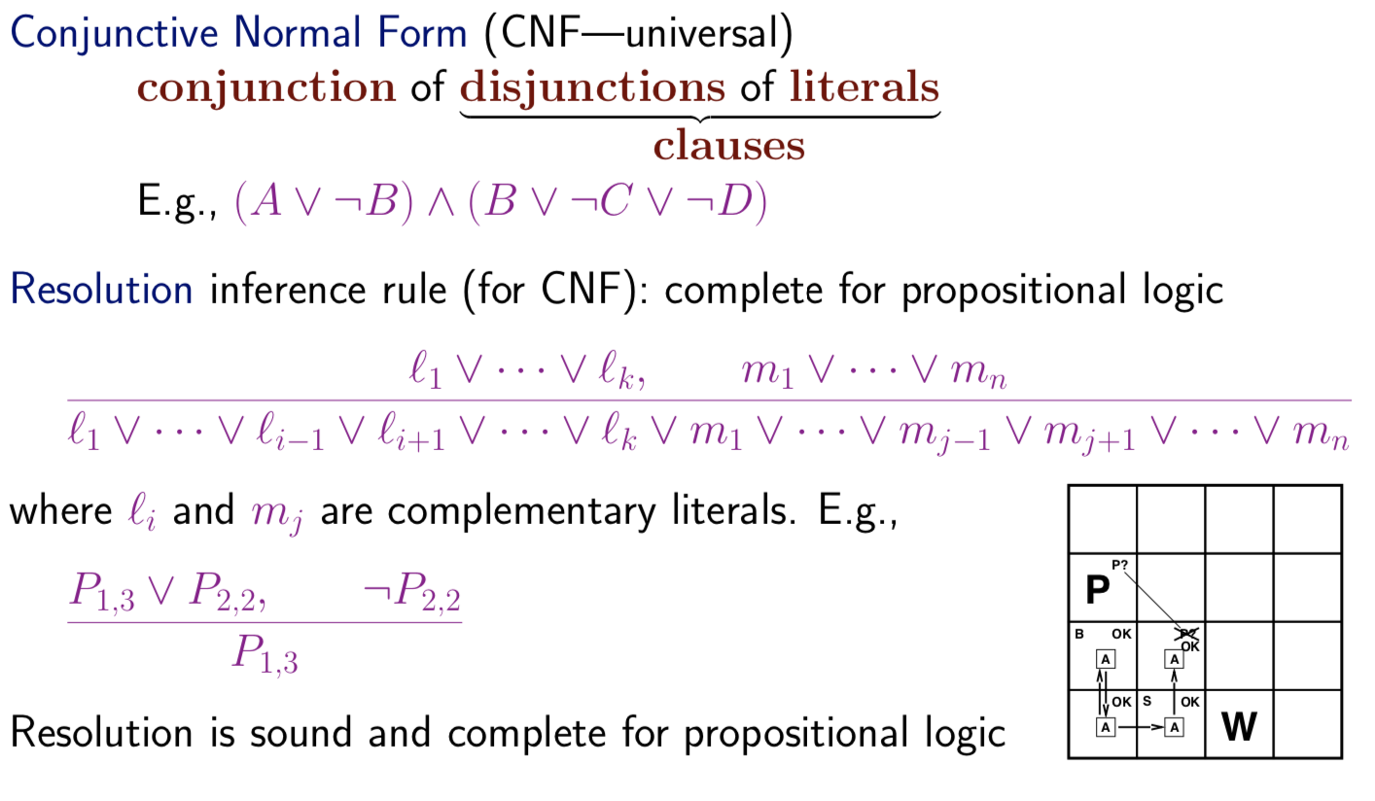
6.5 Propositional Theorem Proving (8/10)
Resolution
사진 출처 #11

Slide 30
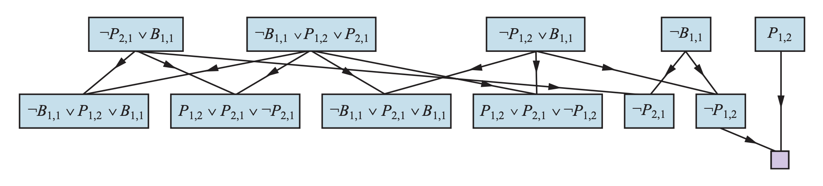
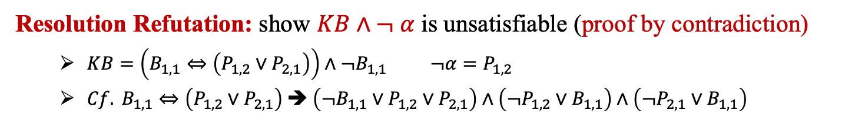
5.3 Propositional Theorem Proving (9/10)
Resolution Refutation: show $KB∧¬ α$ is unsatisfiable (proof by contradiction)
$KB=\left(B_{1,1}⇔\left(P_{1,2}∨P_{2,1}\right)\right)∧¬B_{1,1} ¬α=P_{1,2}$
${Cf. B}_{1,1}⇔\left(P_{1,2}∨P_{2,1}\right) ➔ \left(¬B_{1,1}∨P_{1,2}∨P_{2,1}\right)∧\left(¬P_{1,2}∨B_{1,1}\right)∧\left(¬P_{2,1}∨B_{1,1}\right)$
Example
<출처> Stuart J. Russell and Peter Norvig (2021). Artificial Intelligence: A Modern Approach (4th Edition). Pearson

Slide 31
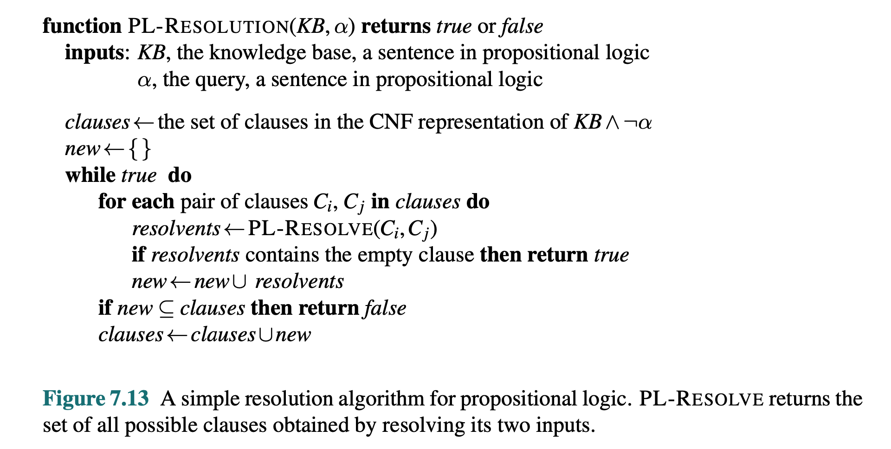
5.3 Propositional Theorem Proving (10/10)
Resolution Algorithm for Propositional Logic
<출처> Stuart J. Russell and Peter Norvig (2021). Artificial Intelligence: A Modern Approach (4th Edition). Pearson

Slide 32
Agents Based on Propositional Logic
A Hybrid Agent
Maintains and updates a knowledge base as well as current plan.
Uses logical inference by asking questions of the knowledge base, to work out which squares are safe, and which have yet to be visited.
Constructs a plan based on a decreasing priority of goals.
Route planning is done with A* search.
Logical State Estimation
The process of updating the belief state as new percepts arrive.
Use a logical sentence involving proposition symbols associated with the current time step.
Approximate state estimation represent belief states as conjunctions of literals (1-CNF formulas)
As time goes along, some information may be lost.

Slide 33
Summary (Part I)
Knowledge is contained in agents in the form of sentences in a knowledge representation language that are stored in a knowledge base.
A representation language is defined by its syntax, which specifies the structure of sentences, and its semantics, which defines the truth of each sentence in each possible world or model.
The relationship of entailment between sentences is crucial to our understanding of reasoning.
The propositional logic is a simple language consisting of proposition symbols and logical connectives, which does not scale to environments of unbounded size.
The inference rules are patterns of sound inference that can be used to find proofs.
The resolution rule yields a complete inference algorithm for knowledge bases that are expressed in conjunctive normal form.
Forward chaining and backward chaining are very natural reasoning algorithms for knowledge bases in Horn form.
The local search methods such as WalkSAT can be used to find solutions. Such algorithms are sound but not complete.

Slide 34
5.4 First-Order Logic

Slide 35
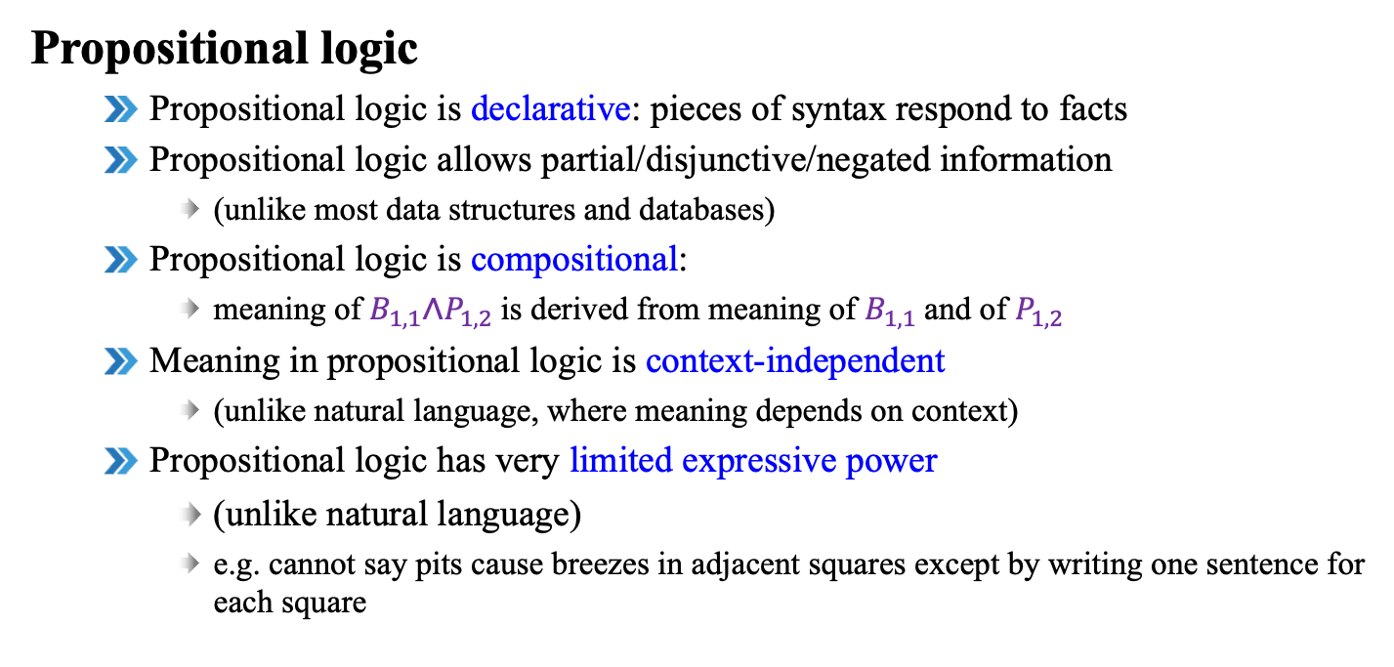
5.4 First-Order Logic (1/8)
Propositional logic
Propositional logic is declarative: pieces of syntax respond to facts
Propositional logic allows partial/disjunctive/negated information
(unlike most data structures and databases)
Propositional logic is compositional:
meaning of $B_{1,1}\text{∧}P_{1,2}$is derived from meaning of $B_{1,1}$and of $P_{1,2}$
Meaning in propositional logic is context-independent
(unlike natural language, where meaning depends on context)
Propositional logic has very limited expressive power
(unlike natural language)
e.g. cannot say pits cause breezes in adjacent squares except by writing one sentence for each square

Slide 36
5.4 First-Order Logic (2/8)
First-order logic
More expressive than propositional logic
Whereas propositional logic assumes world contains facts, first-order logic (like natural language) assumes the world contains
Objects: people, houses, numbers, theories, Ronald McDonald, colors, baseball games, wars, centuries ...
Relations: red, round, bogus, prime, multistoried ..., brother of, bigger than, inside, part of, has color, occurred after, owns, comes between, ...
Unary relations or properties
Functions: father of, best friend, third inning of, one more than, end of

Slide 37
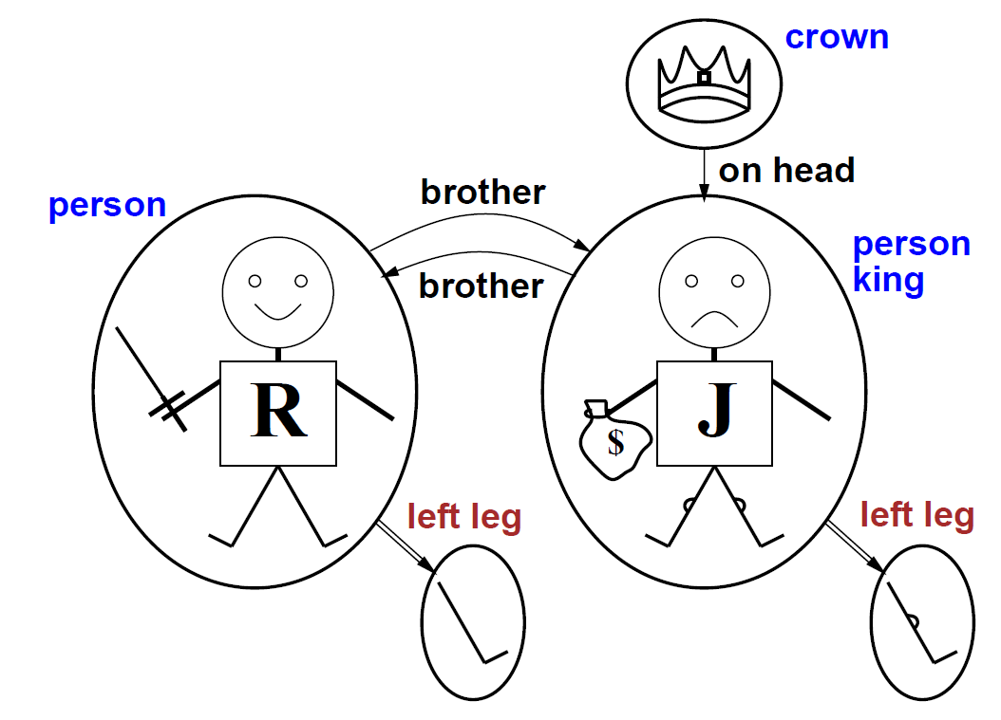
5.4 First-Order Logic (3/8)
Models for FOL: Example
The models of a logical language are the formal structures that constitute the possible worlds under consideration. Each model links the vocabulary of the logical sentences to elements of the possible world, so that the truth of any sentence can be determined.
Objects:
Richard
John
Relations:
Brother
OnHead
Person
King
Crown
Functions
LeftLeg
사진 출처 #2

Slide 38
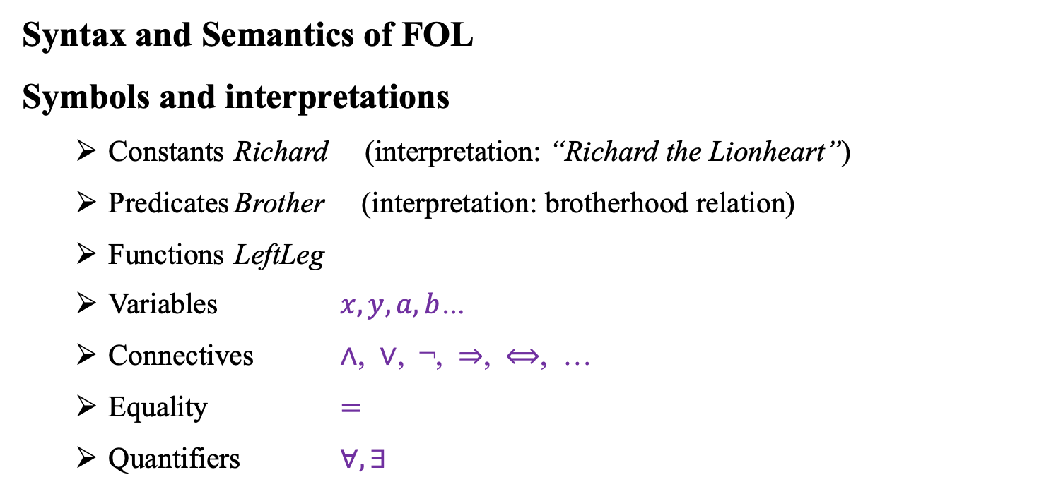
5.4 First-Order Logic (4/8)
Syntax and Semantics of FOL
Symbols and interpretations
Constants Richard (interpretation: “Richard the Lionheart”)
Predicates Brother (interpretation: brotherhood relation)
Functions LeftLeg
Variables $x, y, a,b$…
Connectives ∧, ∨, ¬, ⇒, ⟺, …
Equality $=$
Quantifiers $∀, ∃$

Slide 39
5.4 First-Order Logic (5/8)
Terms
Richard, LeftLeg(Richard)
x, f(x)
Atomic sentences
Brother(Richard, John)
Married(Father(Richard), Mother(John))
Complex sentences
Brother(Richard, John) ∧ Brother(John, Richard)
¬King(Richard) ⇒ King(John)
A term is an logical expression
that refers to an object.
A sentence is a predicate which
can be evaluated as true or false.

Slide 40
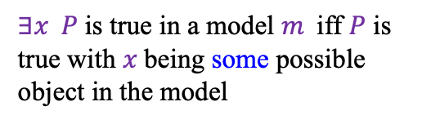
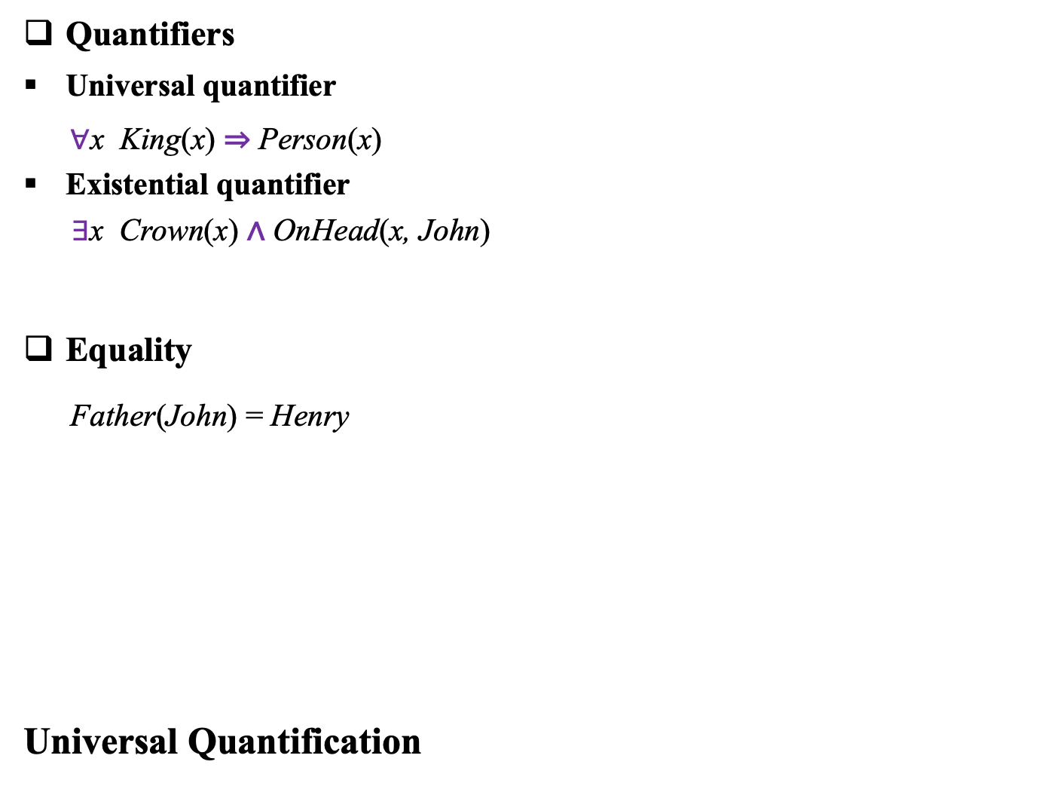
5.4 First-Order Logic (6/8)
Quantifiers
Universal quantifier
$∀$x King(x) ⇒ Person(x)
Existential quantifier
$∃$x Crown(x) ∧ OnHead(x, John)
Equality
Father(John) = Henry
Universal Quantification
Quantifiers express properties of
entire collections of objects, instead of
enumerating the objects by name.
$∃x P$is true in a model $m$iff $P$ is true with $x$being some possible object in the model

Slide 41
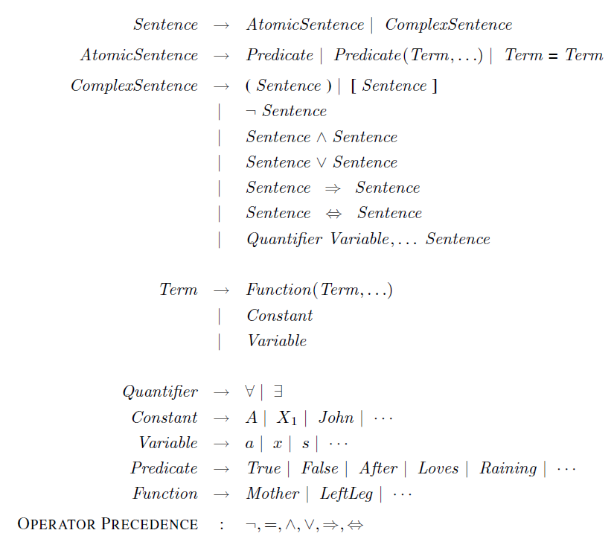
5.4 First-Order Logic (7/8)
The syntax of first-order logic in Backus-Naur form (BNF).
사진 출처 #1

Slide 42
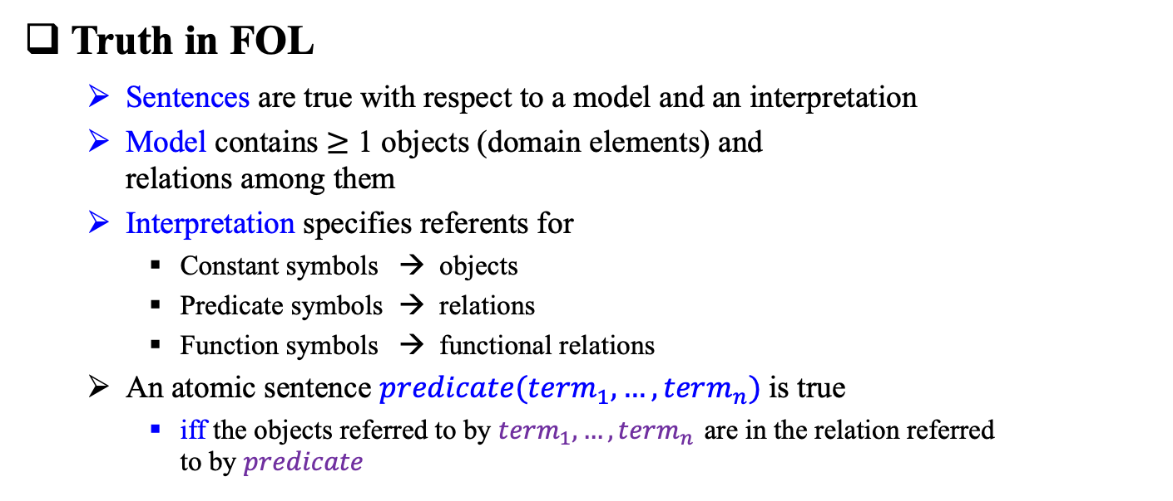
5.4 First-Order Logic (8/8)
Truth in FOL
Sentences are true with respect to a model and an interpretation
Model contains $≥$ 1 objects (domain elements) and relations among them
Interpretation specifies referents for
Constant symbols → objects
Predicate symbols → relations
Function symbols → functional relations
An atomic sentence $predicate(term_{1}, …, term_{n})$is true
iff the objects referred to by $term_{1}, …, term_{n}$ are in the relation referred to by 𝑝𝑟𝑒𝑑𝑖𝑐𝑎𝑡𝑒

Slide 43
5.5 Using First-Order Logic

Slide 44
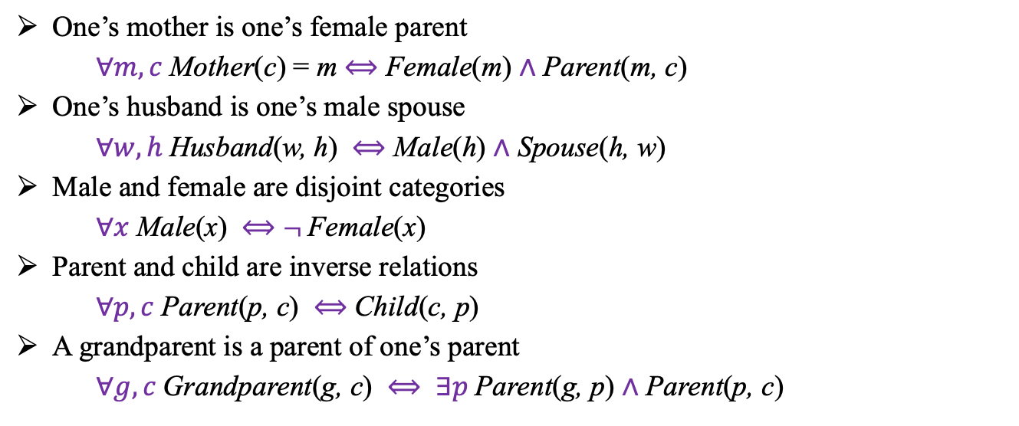
5.5 Using First-Order Logic (1/2)
Family relationships
One’s mother is one’s female parent
$∀m, c$Mother(c) = m $⟺$ Female(m) $∧$ Parent(m, c)
One’s husband is one’s male spouse
$∀w, h$Husband(w, h) $⟺$ Male(h) $∧$ Spouse(h, w)
Male and female are disjoint categories
$∀x$Male(x) $⟺$ $¬$Female(x)
Parent and child are inverse relations
$∀p, c$Parent(p, c) $⟺$ Child(c, p)
A grandparent is a parent of one’s parent
$∀g, c$Grandparent(g, c) $⟺$ $∃p$Parent(g, p) $∧$ Parent(p, c)

Slide 45
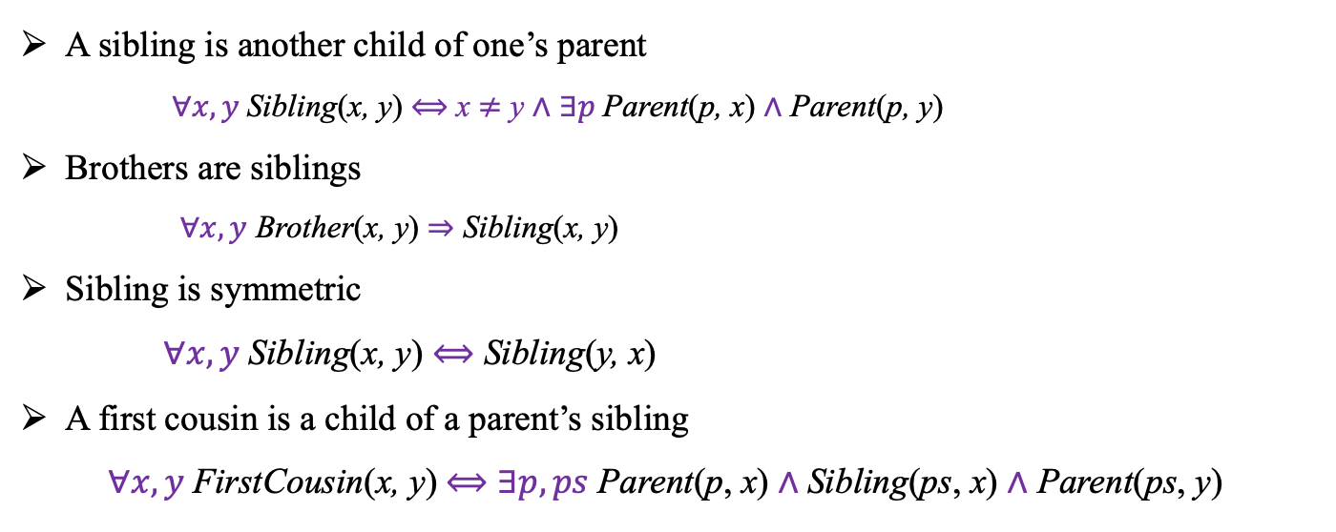
5.5 Using First-Order Logic (2/2)
Family relationships: Sibling
A sibling is another child of one’s parent
$∀x, y$Sibling(x, y) $⟺$ x $≠$ y $∧$ $∃p$Parent(p, x) $∧$ Parent(p, y)
Brothers are siblings
$∀x, y$ Brother(x, y) ⇒ Sibling(x, y)
Sibling is symmetric
$∀x, y$Sibling(x, y) $⟺$ Sibling(y, x)
A first cousin is a child of a parent’s sibling
$∀x, y$FirstCousin(x, y) $⟺$ $∃p, ps$Parent(p, x) $∧$Sibling(ps, x) $∧$ Parent(ps, y)

Slide 46
Knowledge representation languages should be declarative, compositional, expressive, context independent, and unambiguous.
Logics differ in their ontological commitments and epistemological commitments. While PL commits only to the existence of facts, FOL commits to the existence of objects and relations and thereby gains expressive power.
The syntax of FOL extends the PL by adding terms to represent objects, and having universal and existential quantifiers to construct assertions about all or some of the possible values of the quantified variables.
A possible world, or model, for first-order logic includes a set of objects and an interpretation that maps constant symbols to objects, predicate symbols to relations among objects, and function symbols to functions on objects.
An atomic sentence is true just when the relation named by the predicate holds between the objects named by the terms. Extended interpretations, which map quantifier variables to objects in the model, define the truth of quantified sentences.
Developing a KB in FOL requires a careful process of analyzing the domain, choosing a vocabulary, and encoding the axioms required to support the desired inferences.

